Slide 1
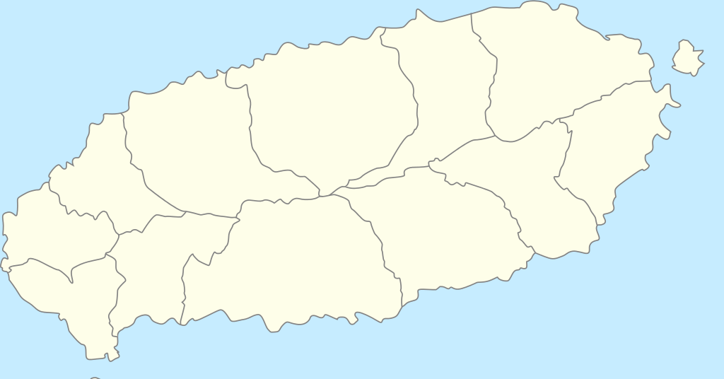
Name: …
Local_X: …
Local_Y: ...
Station Data
Clustering
Frequency
Data
Date: …
From: …
To: …
Date: …
From: …
To: …
NaN
NaN
Tag Data
Data Processing
O-D pattern

